Slide 1
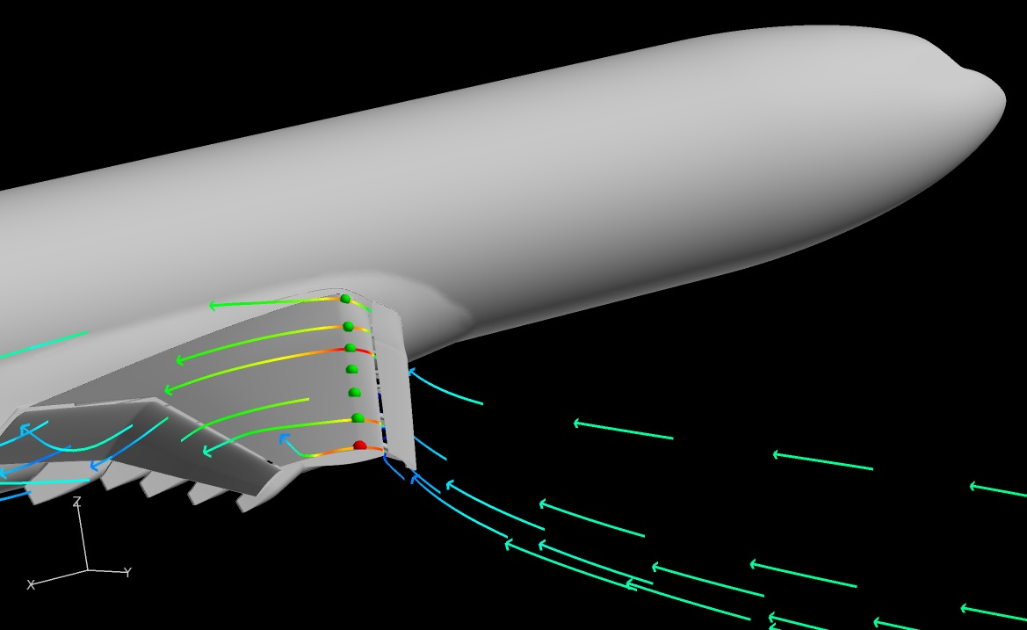
Analysis of CFD Methods in High Lift Configurations
Aaron C. Pigott
Embry-Riddle Aeronautical University

Slide 2
Introduction and Overview
Introduction
  AIAA HighLift Workshop under Dr. Earl Duque and Dr. Shigeo Hayashibara
  Goal: CFD Validation in a High Lift Configuration by comparing CFD to Wind Tunnel data
  Specifically: Validation using velocity profile comparisons
Overview
  The Model
  Experimental Setup
  CFD Setup
  Data
  Points of Interest
  Summary

Slide 3
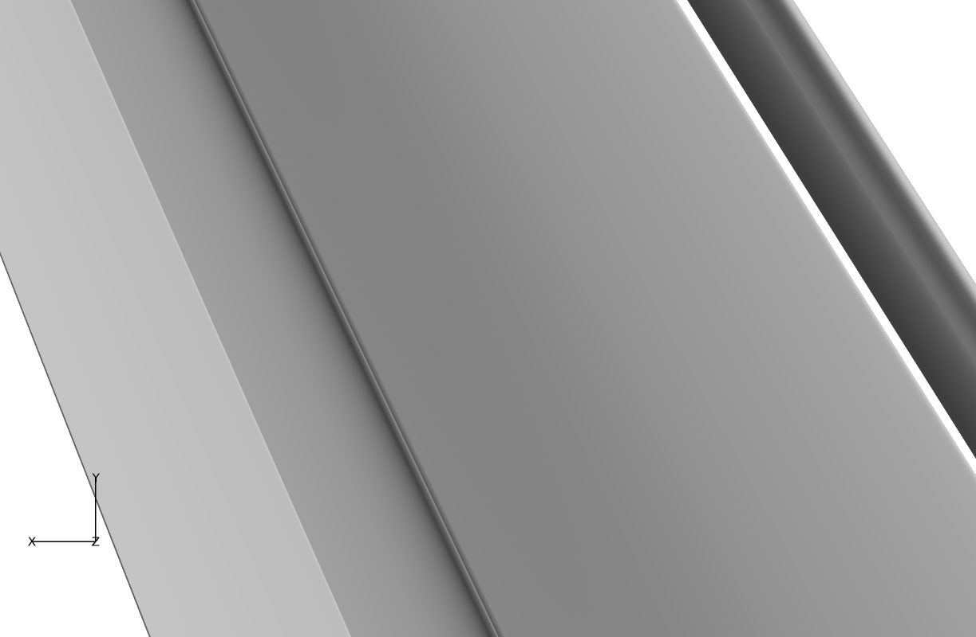
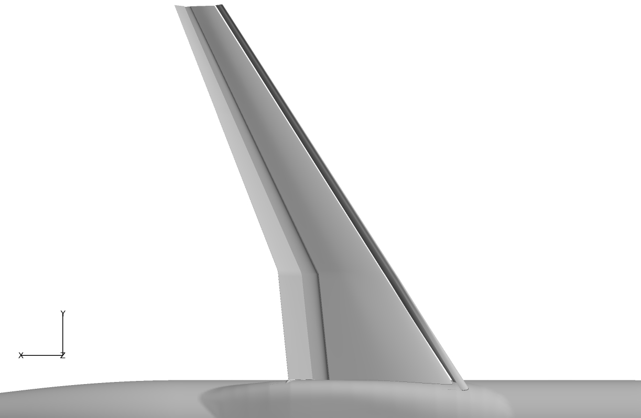
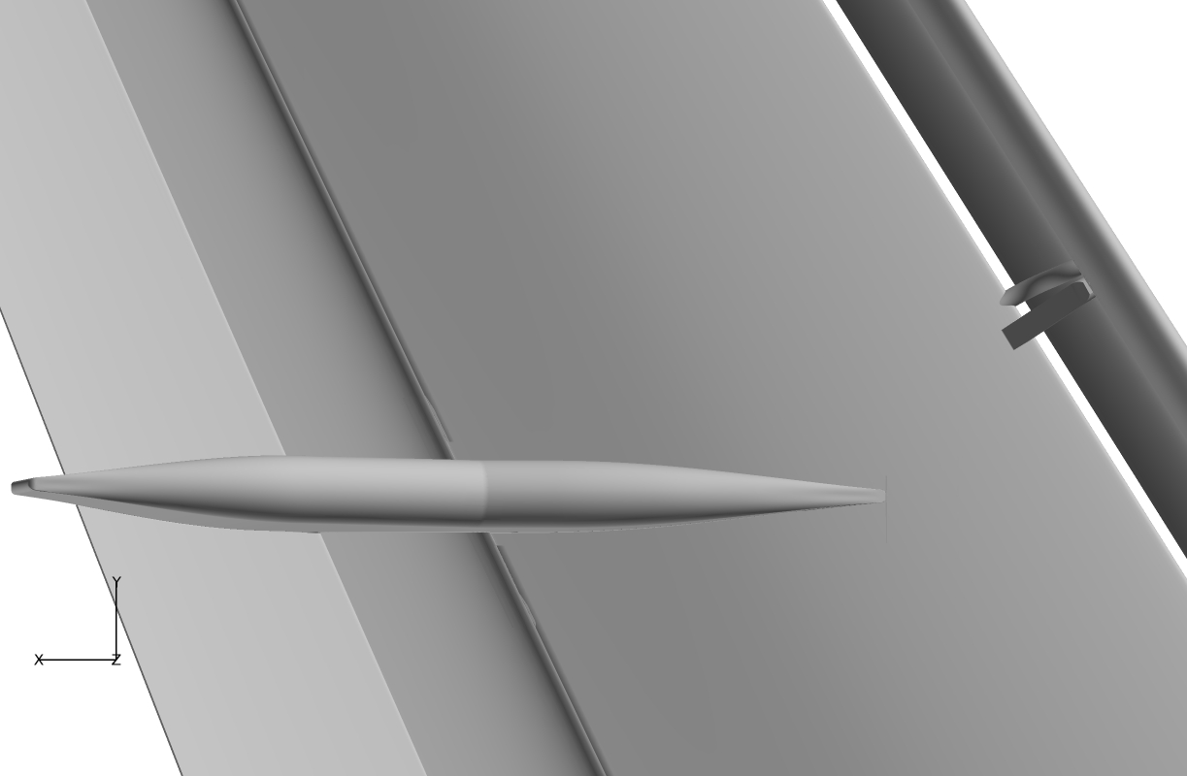



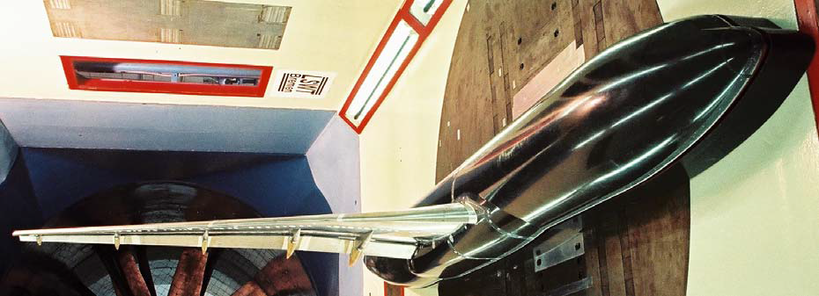
The Model
KH3Y geometry, DLR-F11 model
  Designed to represent wide-body commercial aircraft landing
  Designed for the European High Lift Project
Pressure
Tube
Bundle
Configuration 5
Configuration 2
Configuration 2
Configuration 4
Configuration 4
Configuration 5
Slat
Slat
Slat
Slat
Slat
Slat
Wing
Wing
Wing
Slat Track
Slat Tracks
Flap
Slat Tracks
Slat Track
Flap
Flap
Flap
Flap
Flap
Pressure Tube Bundles
Flap Tracks
Flap Tracks
Fuselage
Fuselage
Fuselage
Flap Track
From AIAA 2012-2924
Flap Track

Slide 4
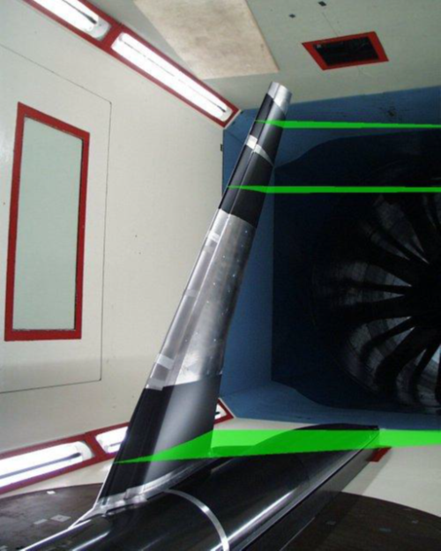
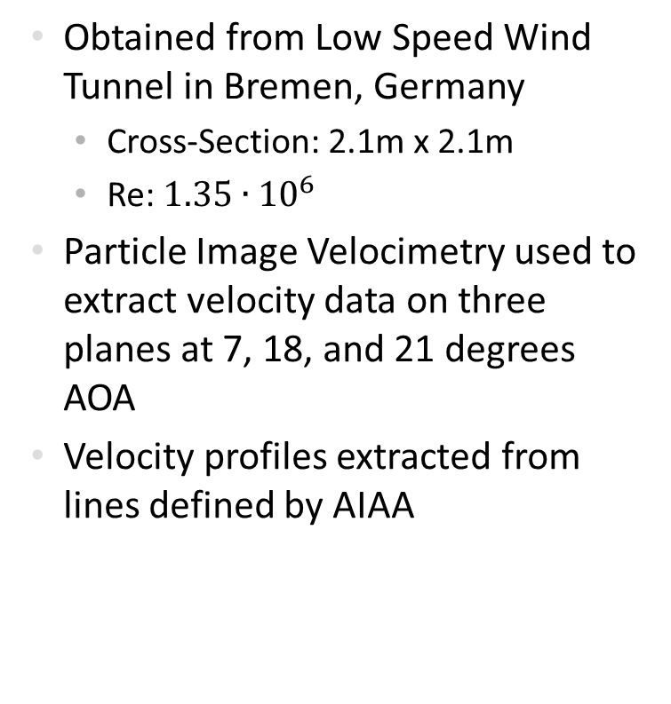
Experimental Data
Obtained from Low Speed Wind Tunnel in Bremen, Germany
  Cross-Section: 2.1m x 2.1m
  Re: $1.35∙{10}^{6}$
Particle Image Velocimetry used to extract velocity data on three planes at 7, 18, and 21 degrees AOA
Velocity profiles extracted from lines defined by AIAA
PIV Planes
From AIAA 2012-2924

Slide 5
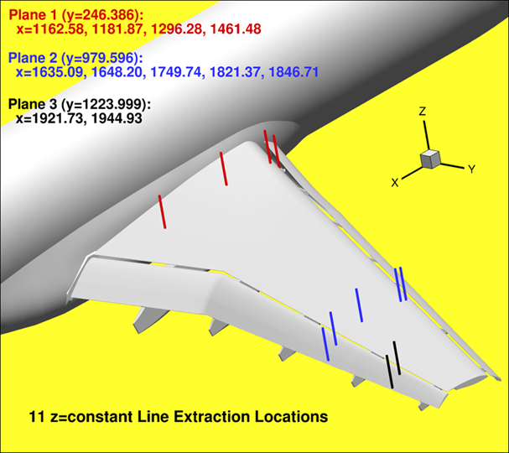
Experimental Data
Plane 1
Plane 2
Plane 3
From AIAA 2012-2924

Slide 6
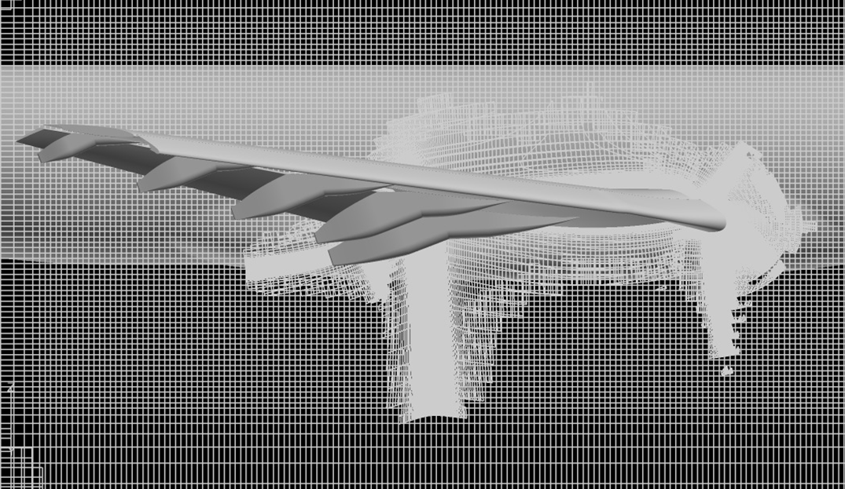

CFD Data: Preprocessor Inputs
Preprocessing performed by Dr. Earl P. N. Duque
Spalart-Allmaras Turbulence Model
Meshing: Overset Grid
  Series of overlayed structured grids
  69 million grid points
Solver: Overflow Code
  Reynolds-Averaged Navier-Stokes solver by Pieter Buning, NASA Langley
$\text{Re}\text{: }1.35∙{10}^{6}$
Simulations performed on Cray XE6 system
  1024 compute cores
  Each simulation required 24 hours to converge
Notes:
Reynolds number using mean aerodynamic chord

Slide 7

CFD Data: Testing
  Extract u-velocity profile from 11 locations on wing at 7, 18.5, and 21 degrees AOA
  CFD: Extraction lines at same locations as experimental
From AIAA 2012-2924

Slide 8
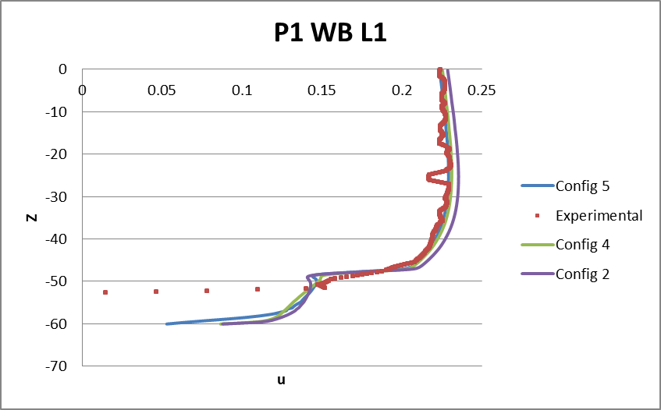
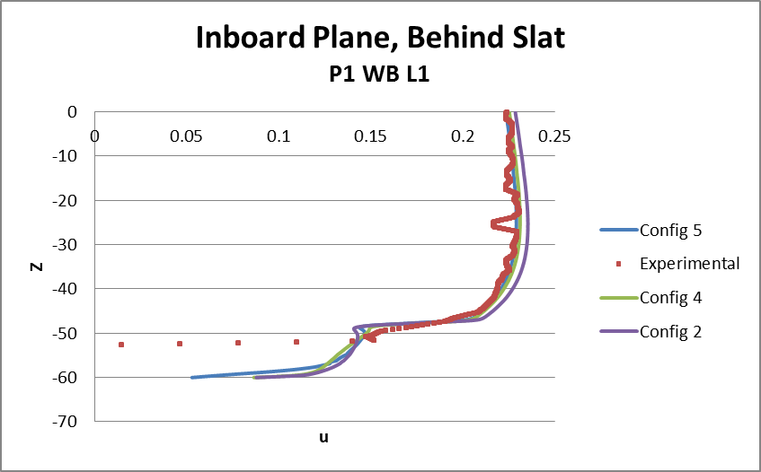
The Data
Z: Direction normal to the chord
Non-dimensionalized velocity in x-direction

Slide 9
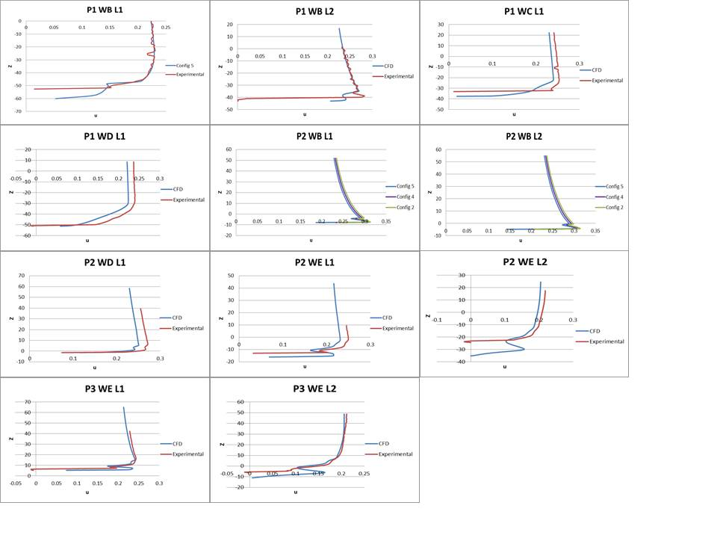
Velocity Profile Data: AOA 7

Slide 10
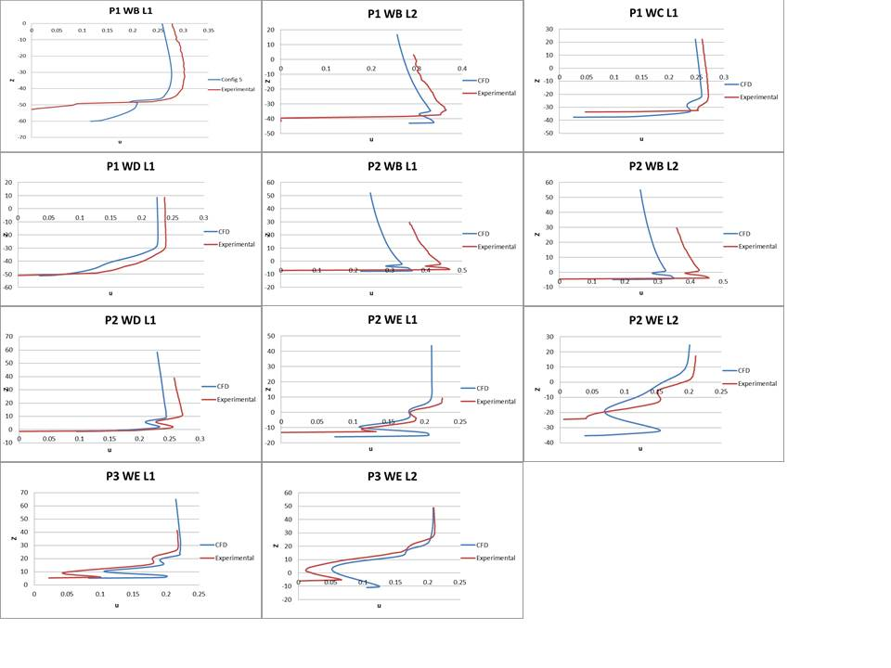
Velocity Profile Data: AOA 18.5

Slide 11
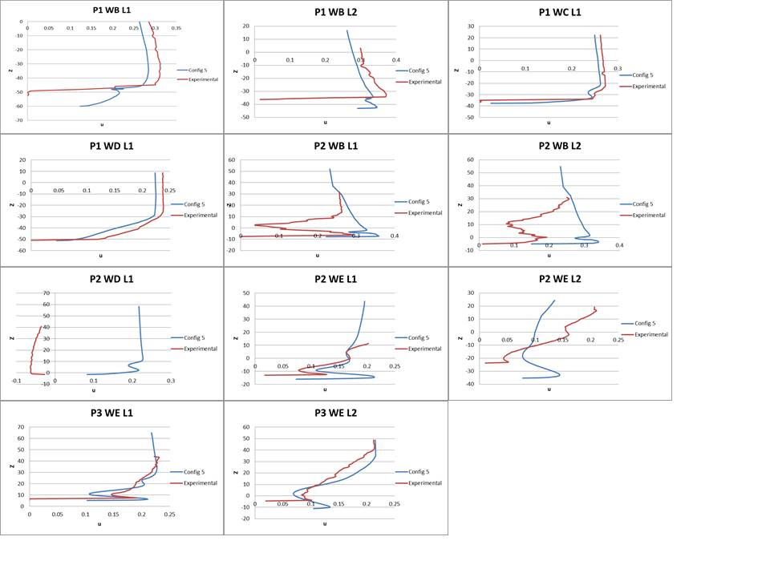
Velocity Profile Data: AOA 21

Slide 12
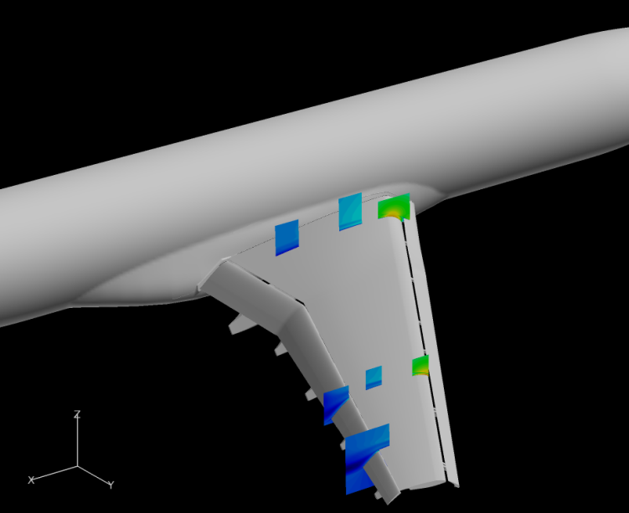
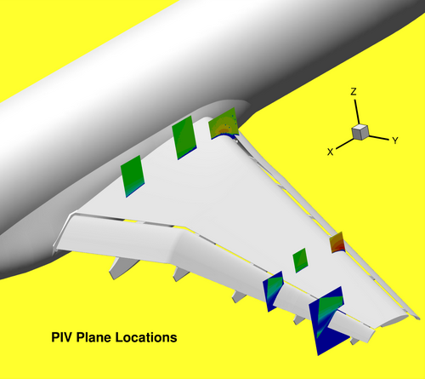
Points of Interest
Small divots appear in experimental data velocity profiles
As angle of attack increases, correlation between CFD and PIV data decreases
A few locations show very little correlation between CFD and Experimental velocity data (Plane 2 Window B)
CFD does not detect reverse flow shown in Plane 2 window D

Slide 13
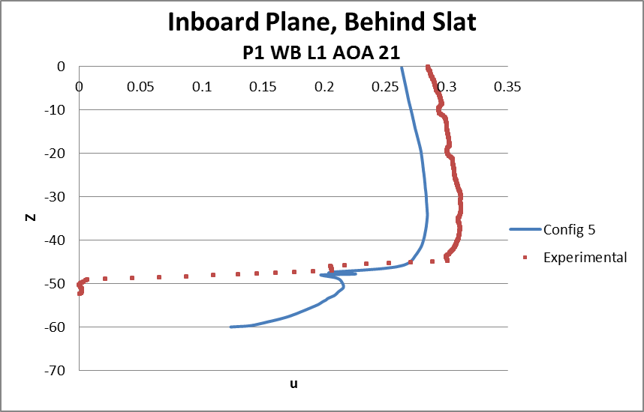
Experimental Data Divots
Model wing made out of polished steel
Thin, black adhesive foil had to be added to reduce reflection off model surface
Hypothesis: Imperfections in foil may have caused divots seen in experimental velocity profile
Divots
From AIAA 2012-2924

Slide 14
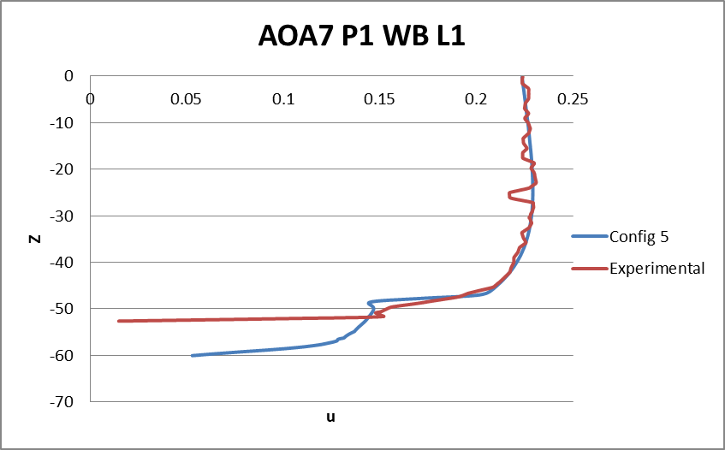

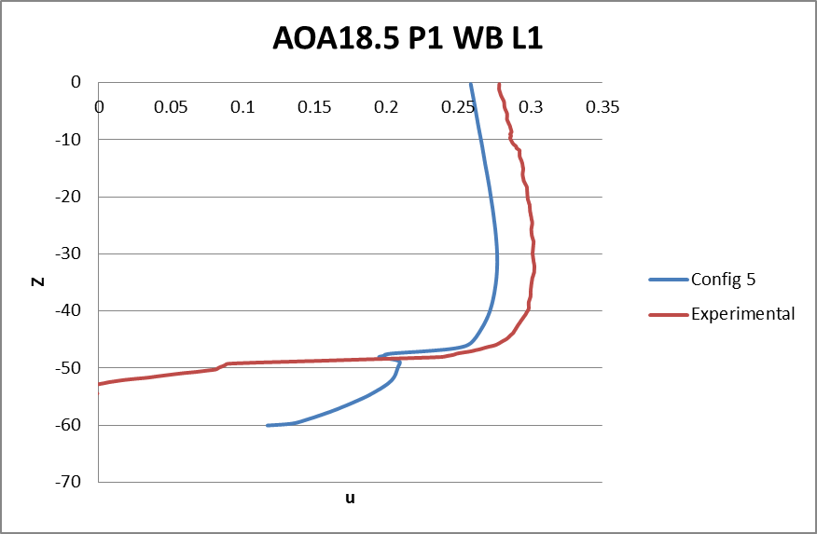
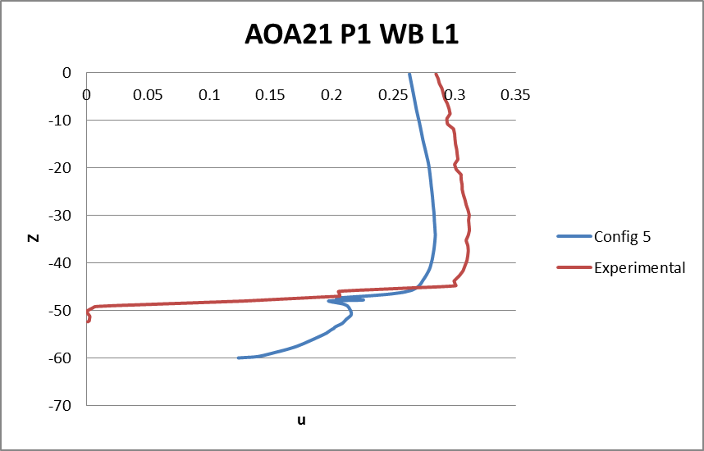
Increasing AOA, Decreasing Correlation

Slide 15
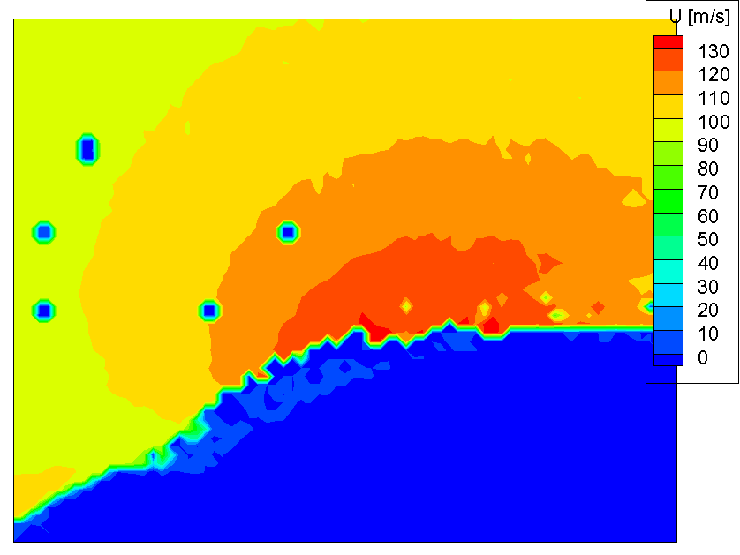
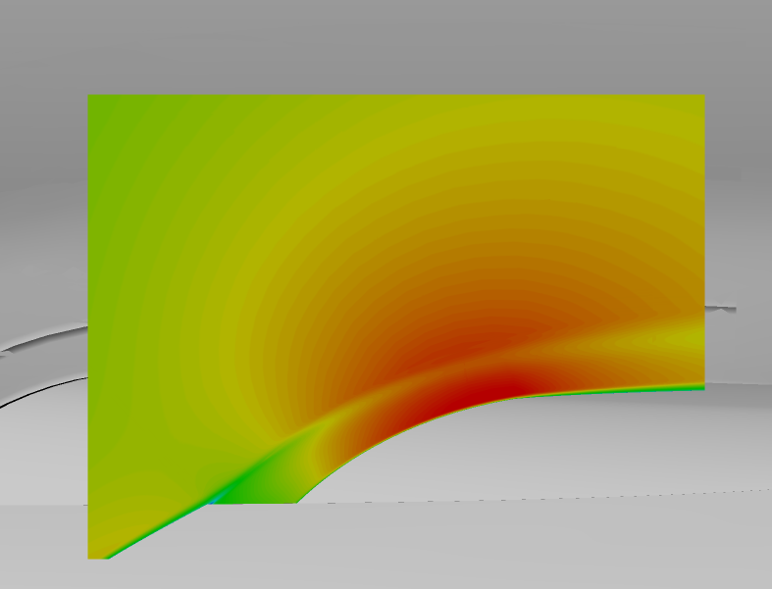

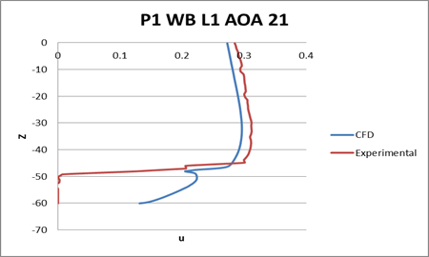
AOA 21 Plane 1 Window B
Experimental
FieldView

Slide 16
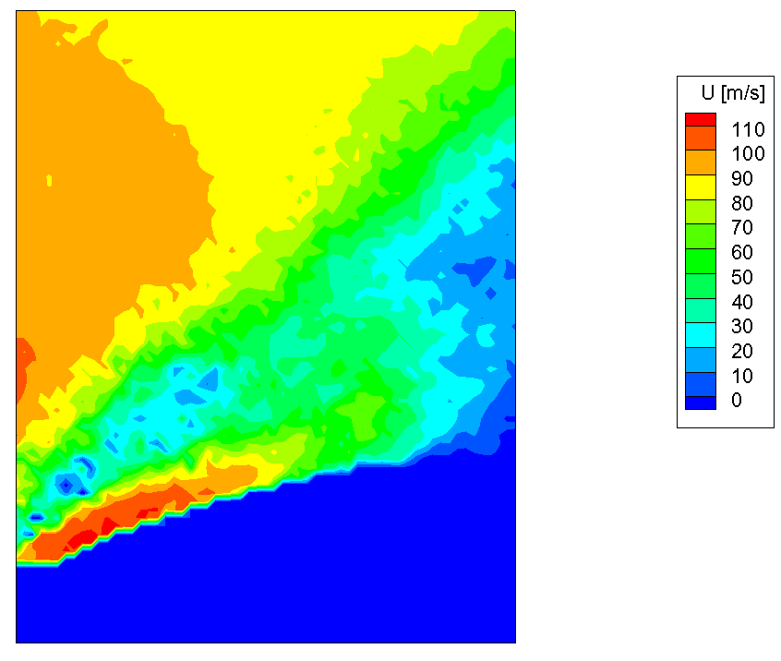
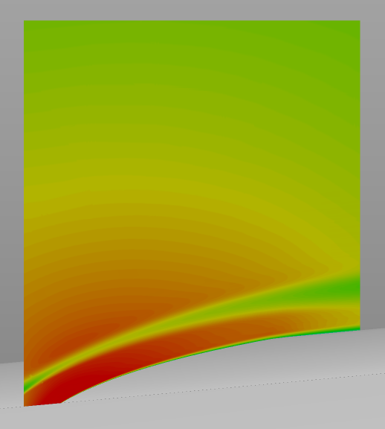

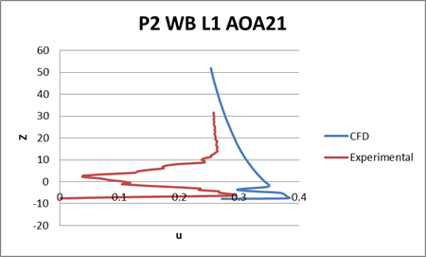
AOA 21 Plane 2 Window B
Experimental (PIV)
CFD (FieldView)
Small
Slat
Wake
Large
Slat
Wake

Slide 17
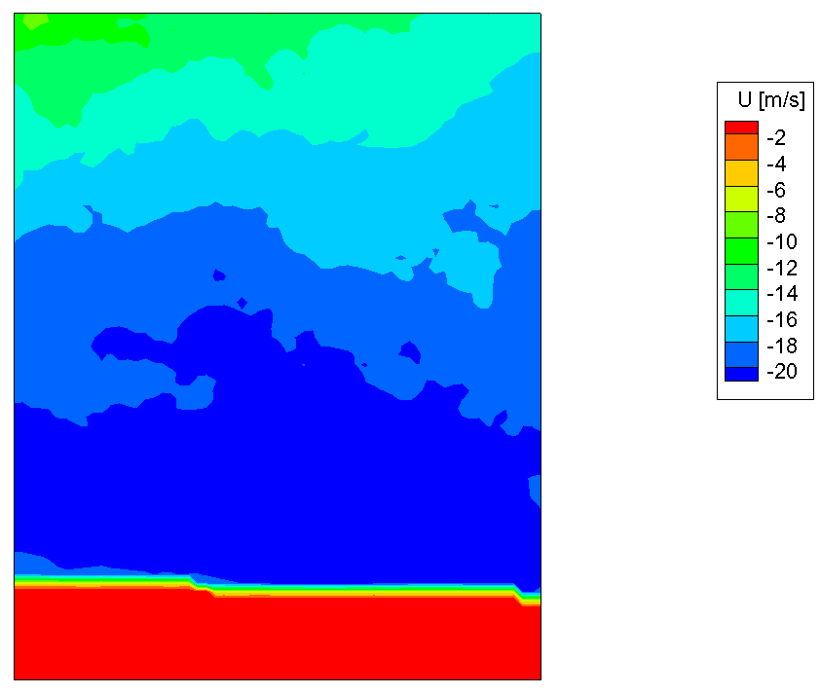

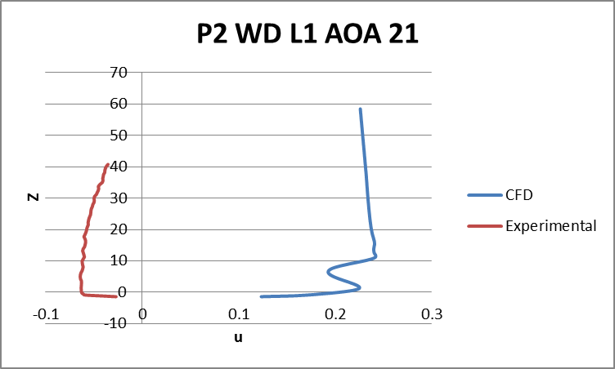
Reverse Flow: Plane 2 Window D
There is reverse flow shown in the experimental data in Plane 2 Window D
CFD did not show reverse flow on this plane
(PIV Plot)

Slide 18
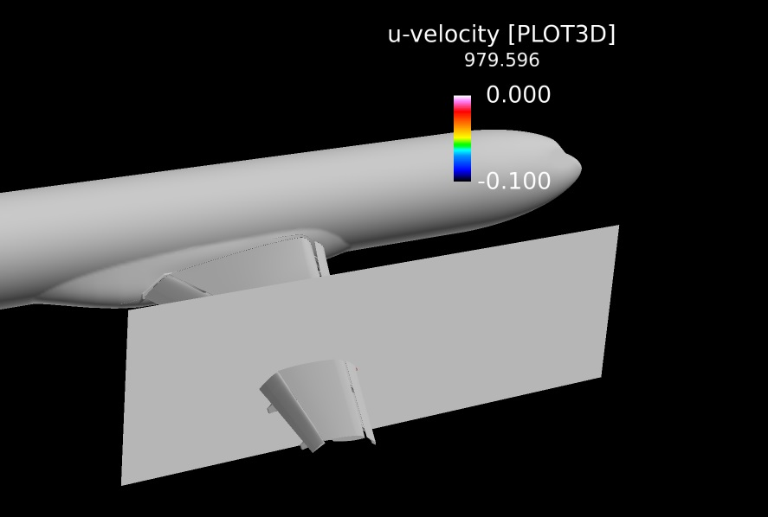
Plane 2 (y = 979.596 mm)

Slide 19
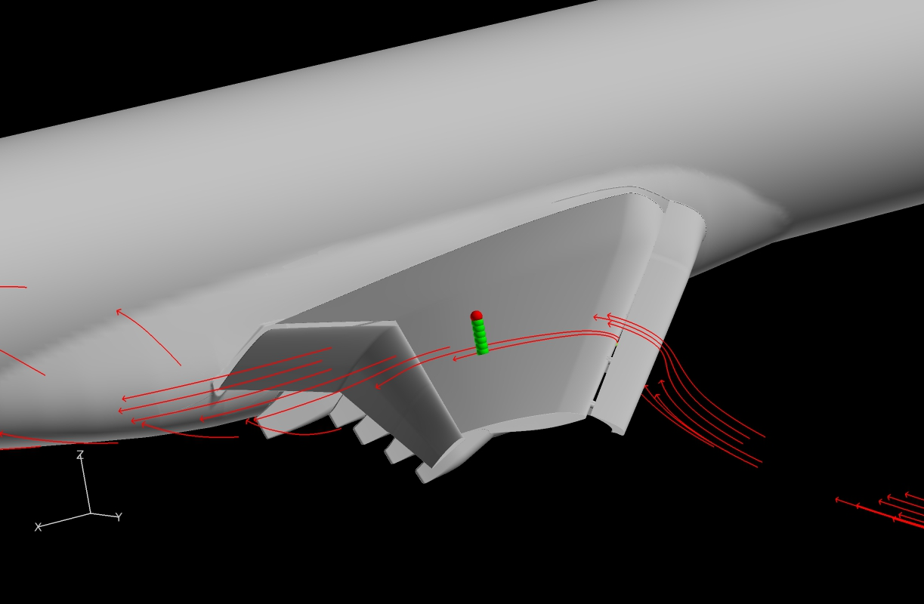
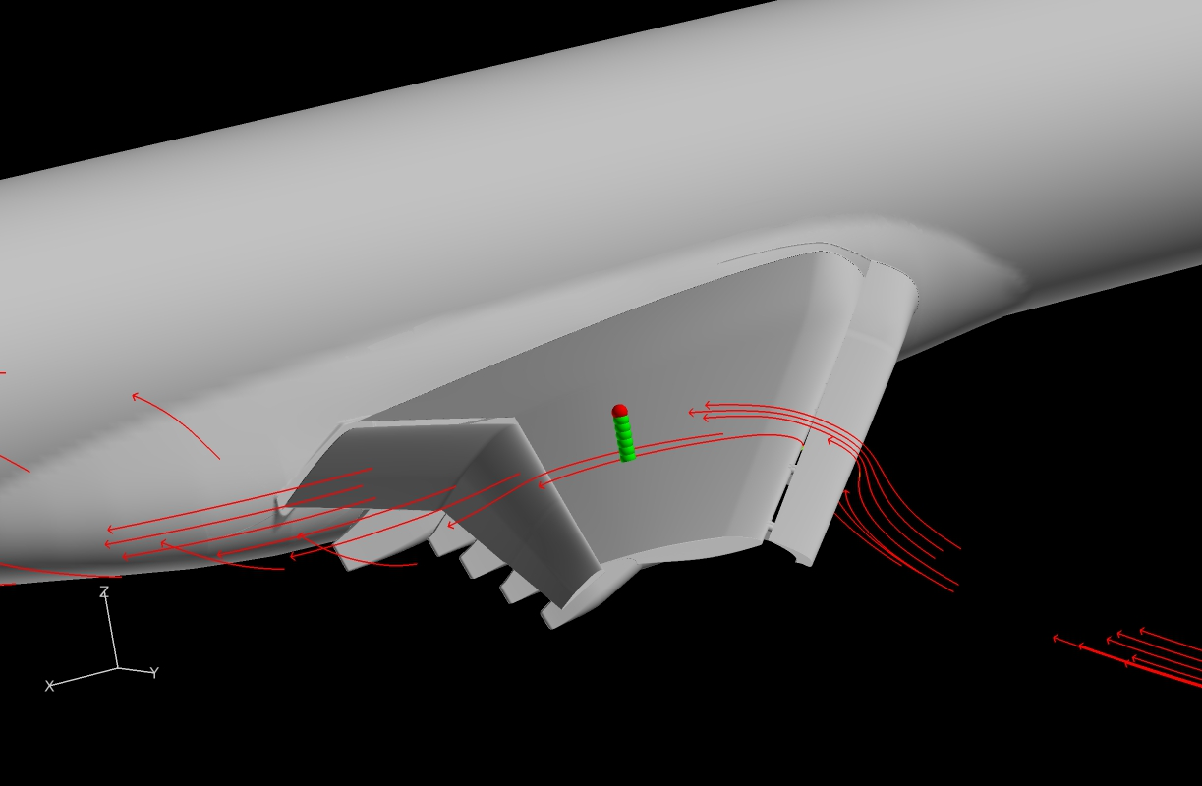
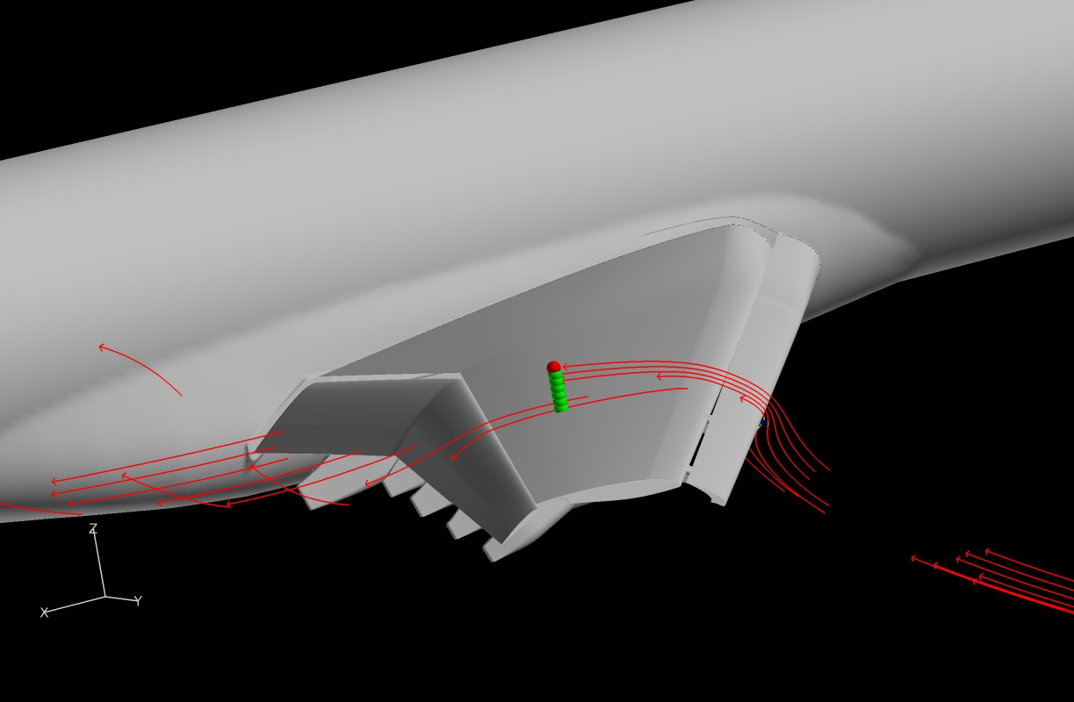


Plane 2 (y = 979.596 mm)

Slide 20
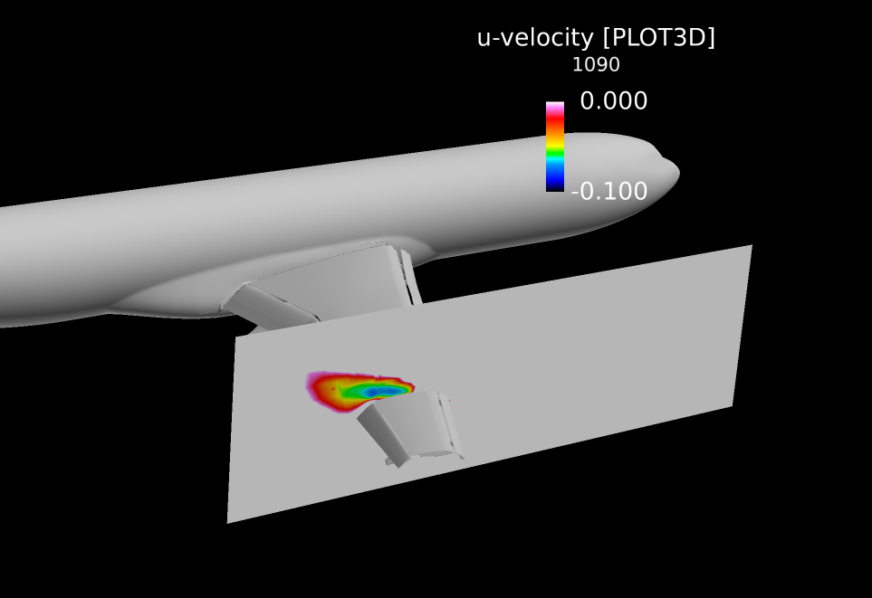
Plane y = 1090 (mm)

Slide 21
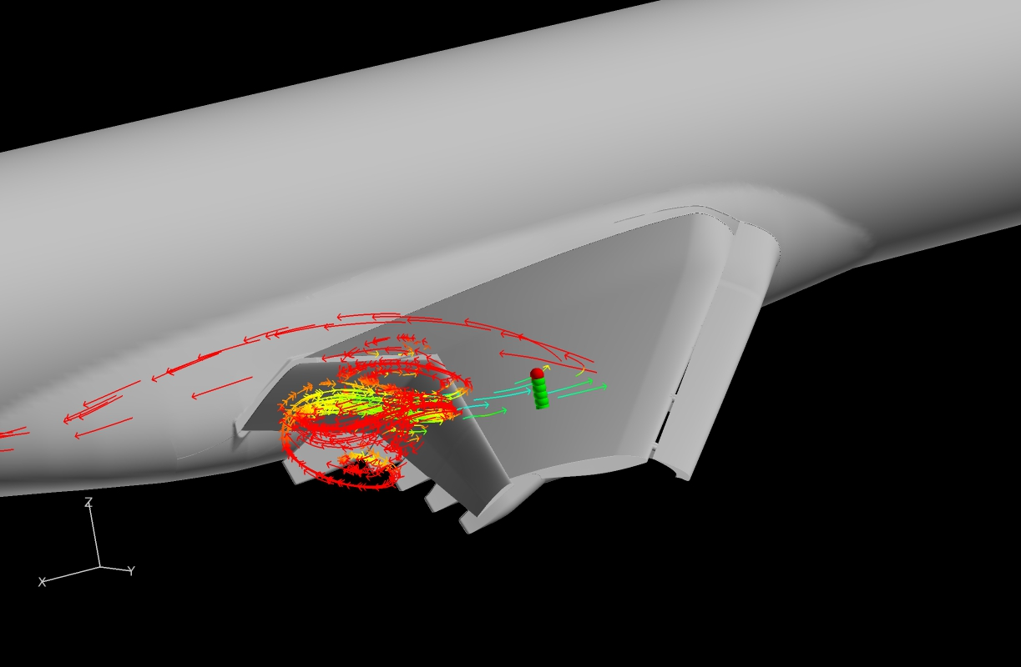



Plane y = 1090 (mm)

Slide 22
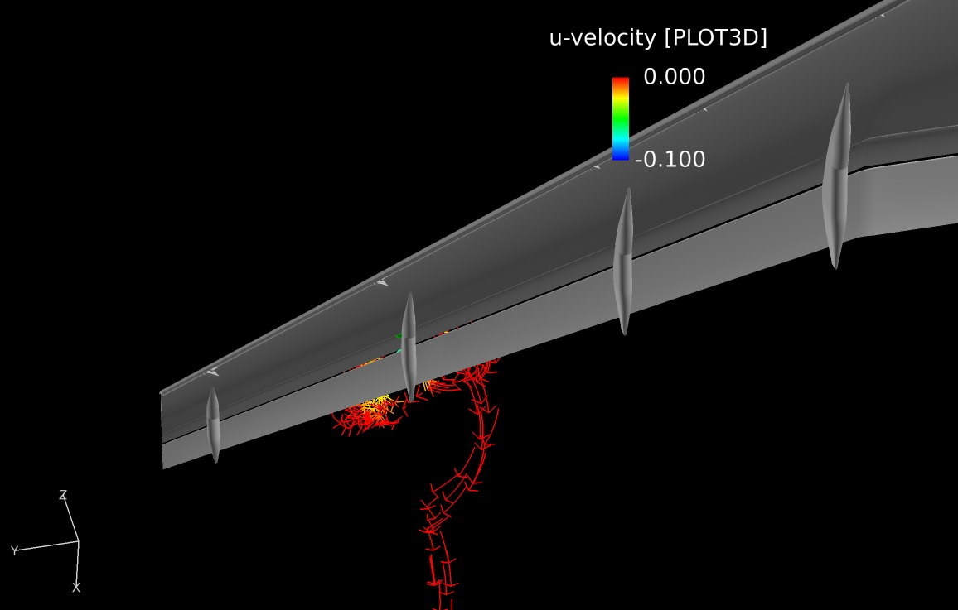
Plane y = 1090 (mm)
Slat Track and
Pressure Tube Bundle

Slide 23
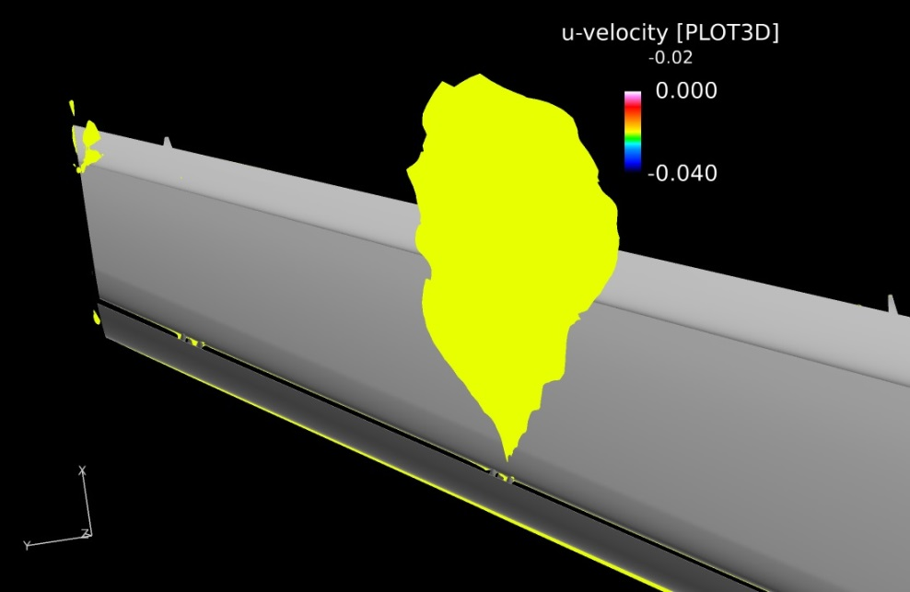
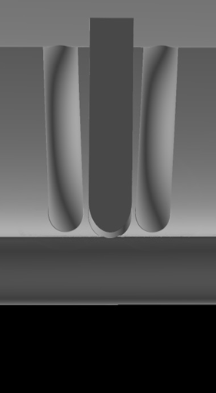
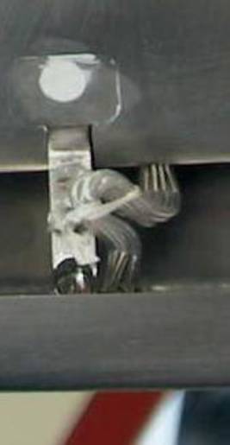
Reverse Flow Shift Outboard
CFD shows airflow separation 100mm further outboard than the PIV data
The shift is likely due to model pressure tube representation
CFD Model Pressure
Tubes
DLR-F11 Pressure
Tubes

Slide 24
Summary
At low AOA, CFD data does an excellent job describing existing flow phenomena
As AOA increases, CFD and Experimental velocity profiles correlate less
CFD shows flow separation further outboard than the PIV data

Slide 25
Acknowledgements
CFD images were created using FieldView as provided by Intelligent Light through its University Partners Program
Simulations were performed by Dr. Earl P.N. Duque, Manager of Applied Research, Intelligent Light
  Dr. Shigeo Hayashibara, ERAU CFD Research Group

Slide 26
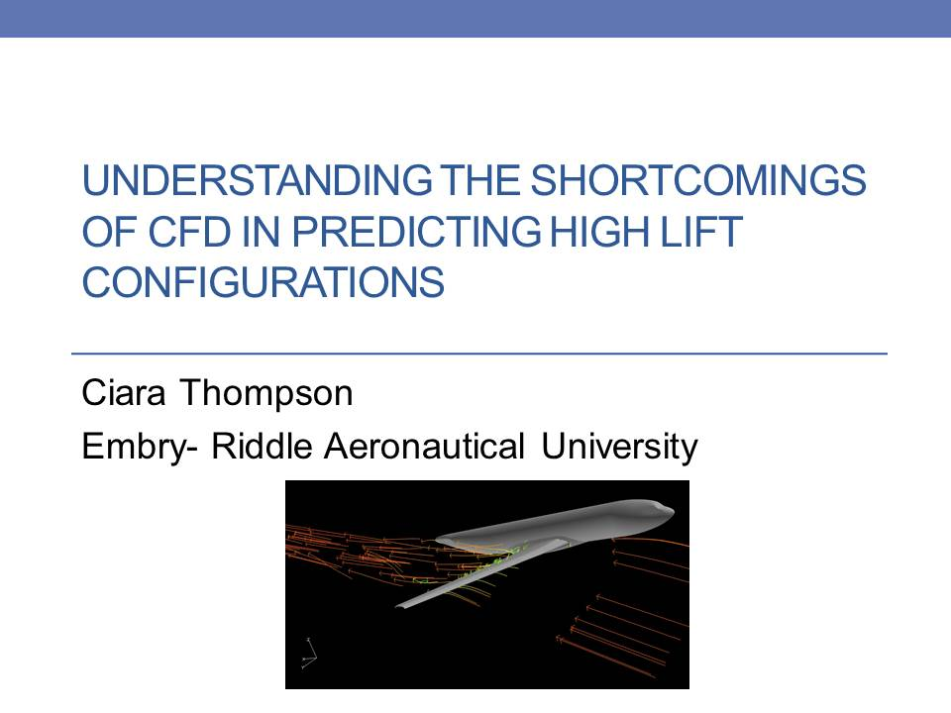

Slide 27
Questions?

Slide 28

Appendix
To non-dimensionalize the experimental data, the velocity was divided by the speed of sound
The speed of sound for this experiment:
$a= \frac{V}{M}= \frac{60 m/s}{.175}=342.857m/s$

Slide 29
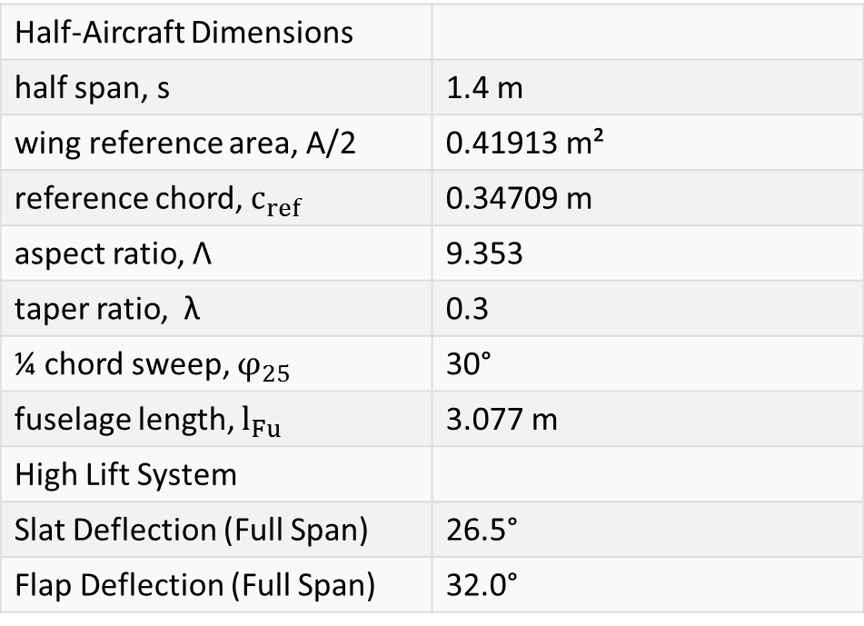
The Model: Dimensions
Half-Aircraft Dimensions
half span, s | 1.4 m
wing reference area, A/2 | 0.41913 m²
reference chord, $c_{ref}$ | 0.34709 m
aspect ratio, Λ | 9.353
taper ratio, λ | 0.3
¼ chord sweep, $φ_{25}$ | 30°
fuselage length, $l_{Fu}$ | 3.077 m
High Lift System
Slat Deflection (Full Span) | 26.5°
Flap Deflection (Full Span) | 32.0°

Slide 30
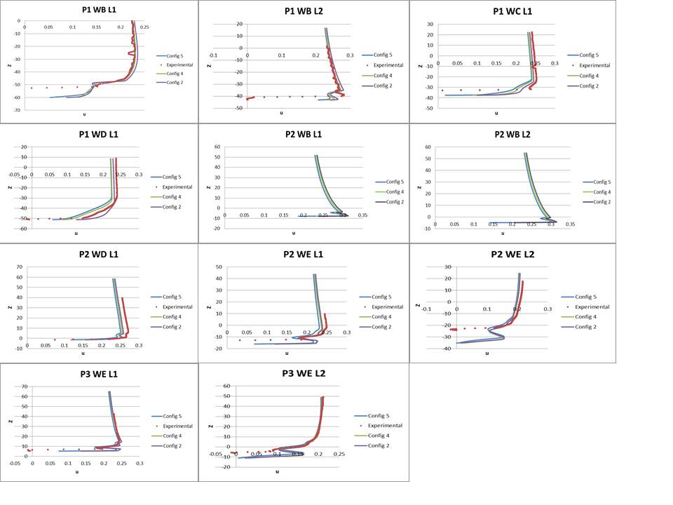
AOA 7 Data w/ All Configs

Slide 31
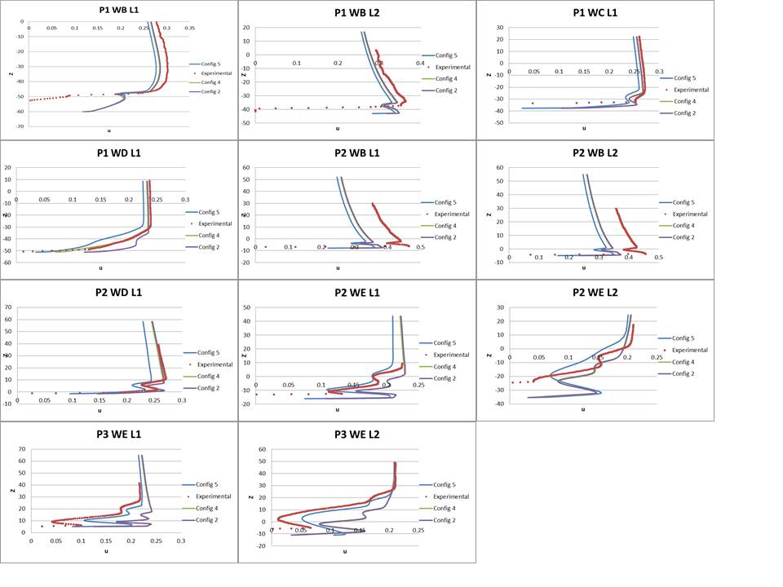
AOA 18.5 Data w/ All Configs

Slide 32
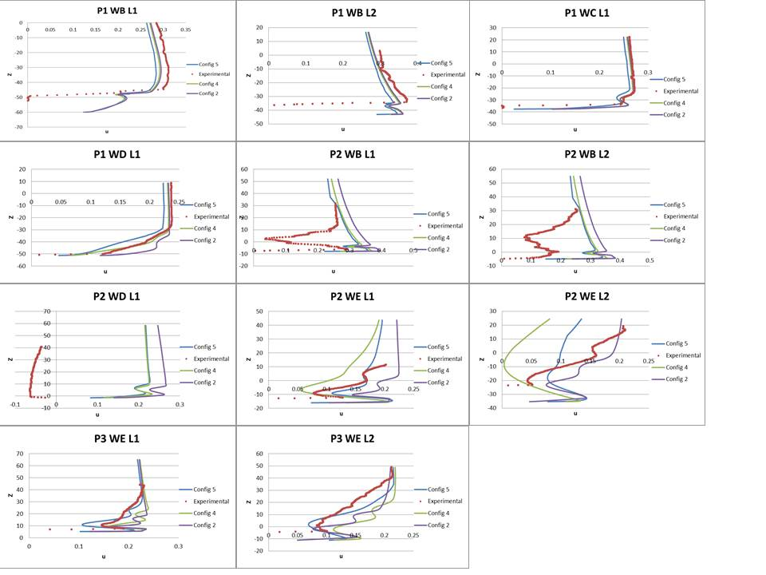
AOA 21 Data w/ All Configs

Slide 33
Why do we care about Velocity Profiles?
Velocity profiles paint a picture of airflow at different locations on the surface of the wing. They point out flow phenomena such as separation.

Slide 34
Why was S-A turbulence model used?
Designed specifically for aerospace applications
Shown to give good results for boundary layers subjected to adverse pressure gradients
Solves a modeled transport equation for kinematic eddy viscosity

Slide 35
At what AOA does model stall?
From: AIAA 2012-2924

